Slide 1
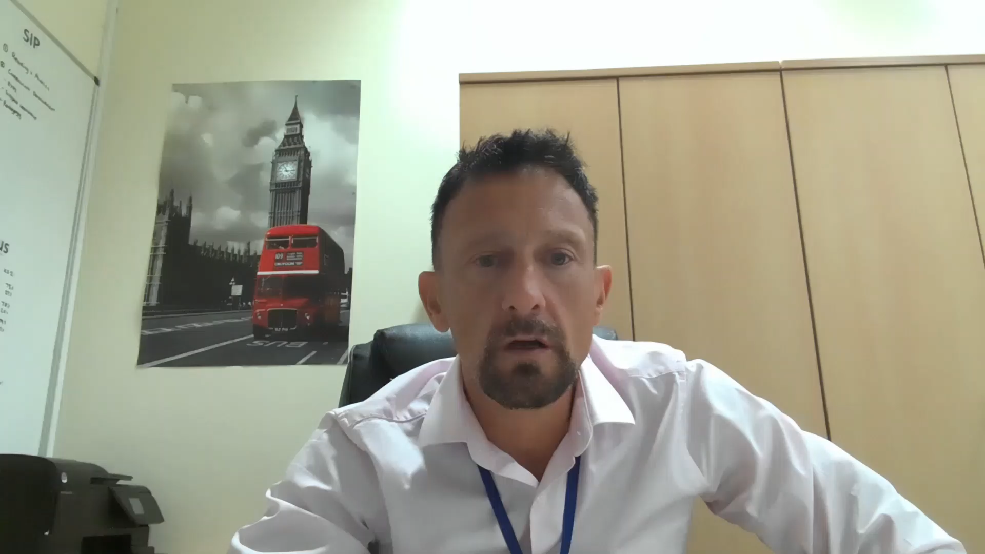
St John with St Augustine CE Primary School
Induction Evening 2020
June 2020: Messages from the headteacher
Click to play

