Slide 1
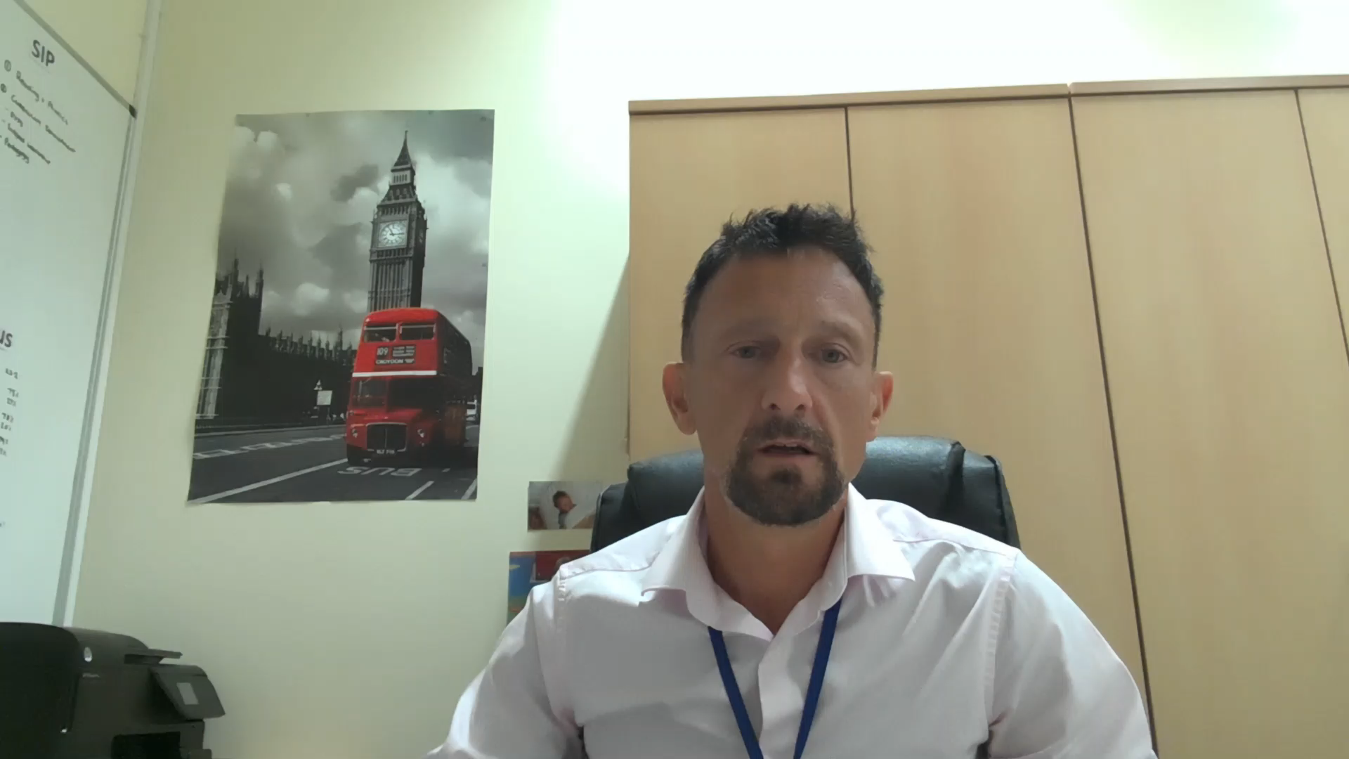
Starting school
Click to play
Exciting
Worrying
Will they be happy?
A new chapter
Letting go!

