Slide 1

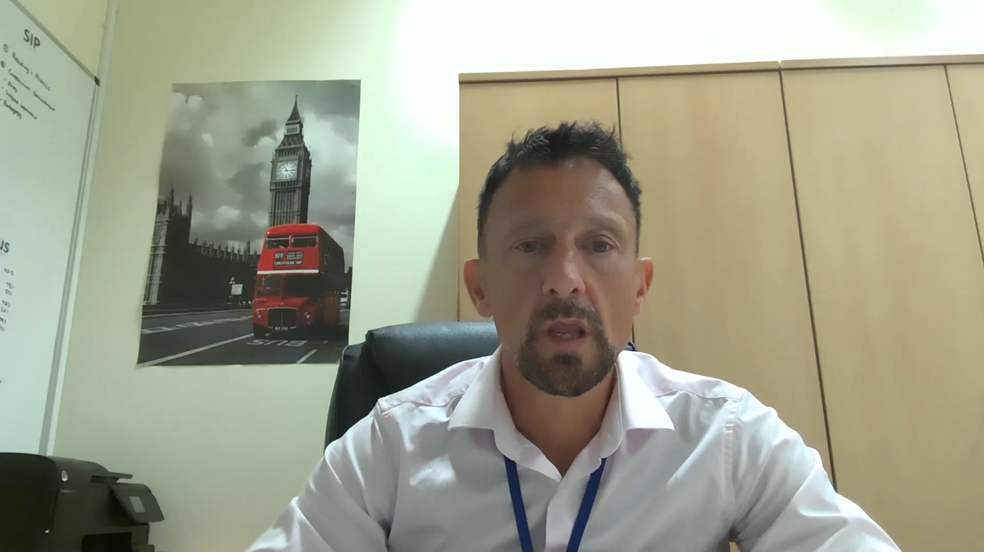
St John with St Augustine
The school was inspected in February 2018 by Ofsted and was judged to be a good school
Some of the most pleasing comments we found in the report were regarding:
“excellent behaviour”
“meticulous records”
“high expectations”
“high standards”
“Teaching is consistently good”
“high quality writing”
“provides a nurturing environment”
“bullying rarely happens.”
Click to play

