Slide 1
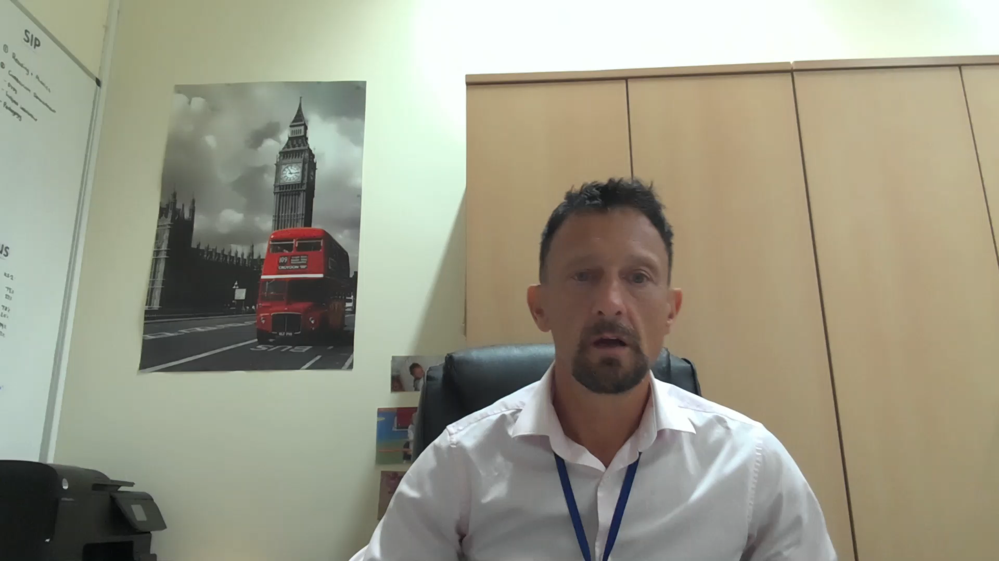
SIAMS Inspection
January 2017
Outstanding
Click to play

