Slide 1
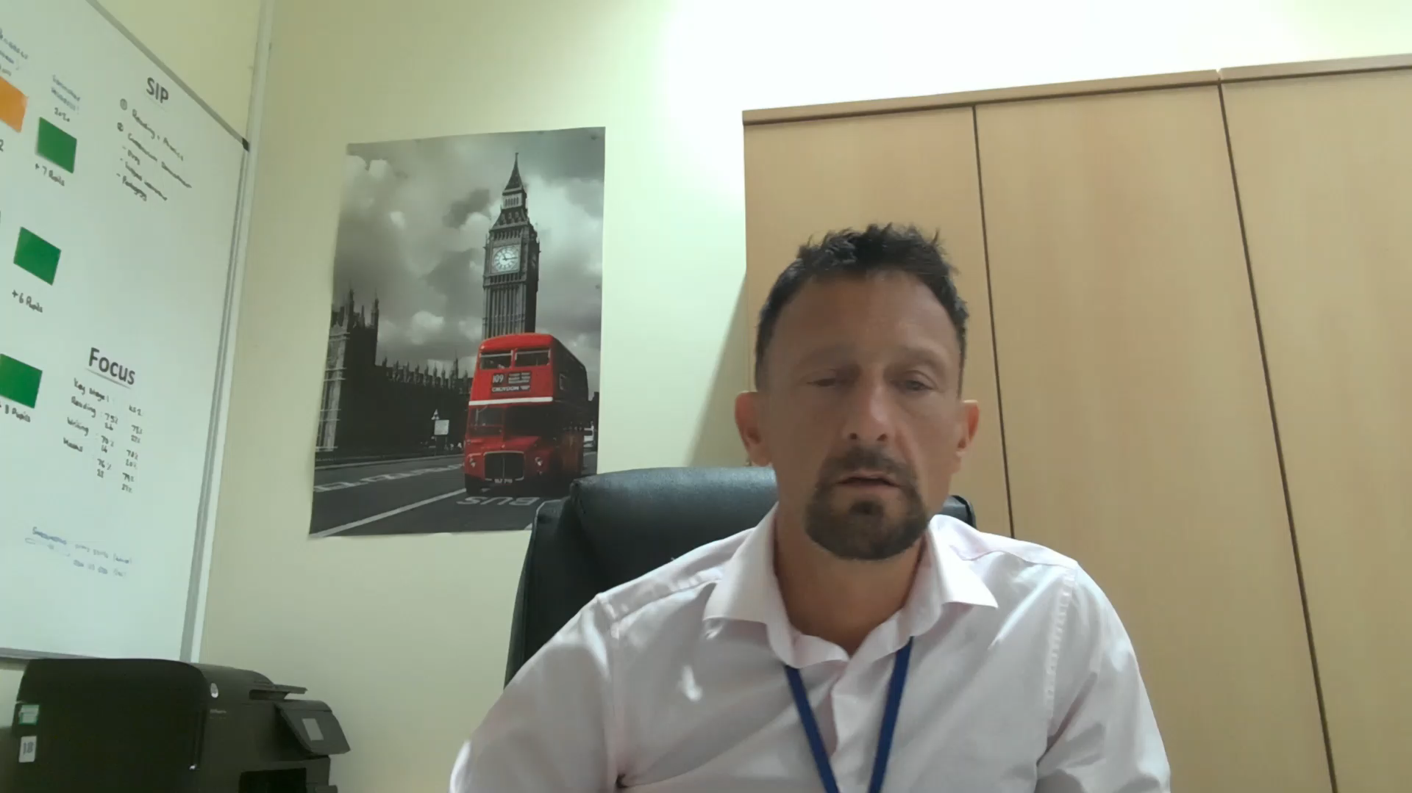
What our pupils say
Lessons are challenging but fun!
We are making good progress!
We know how to improve!
Click to play

