Slide 1
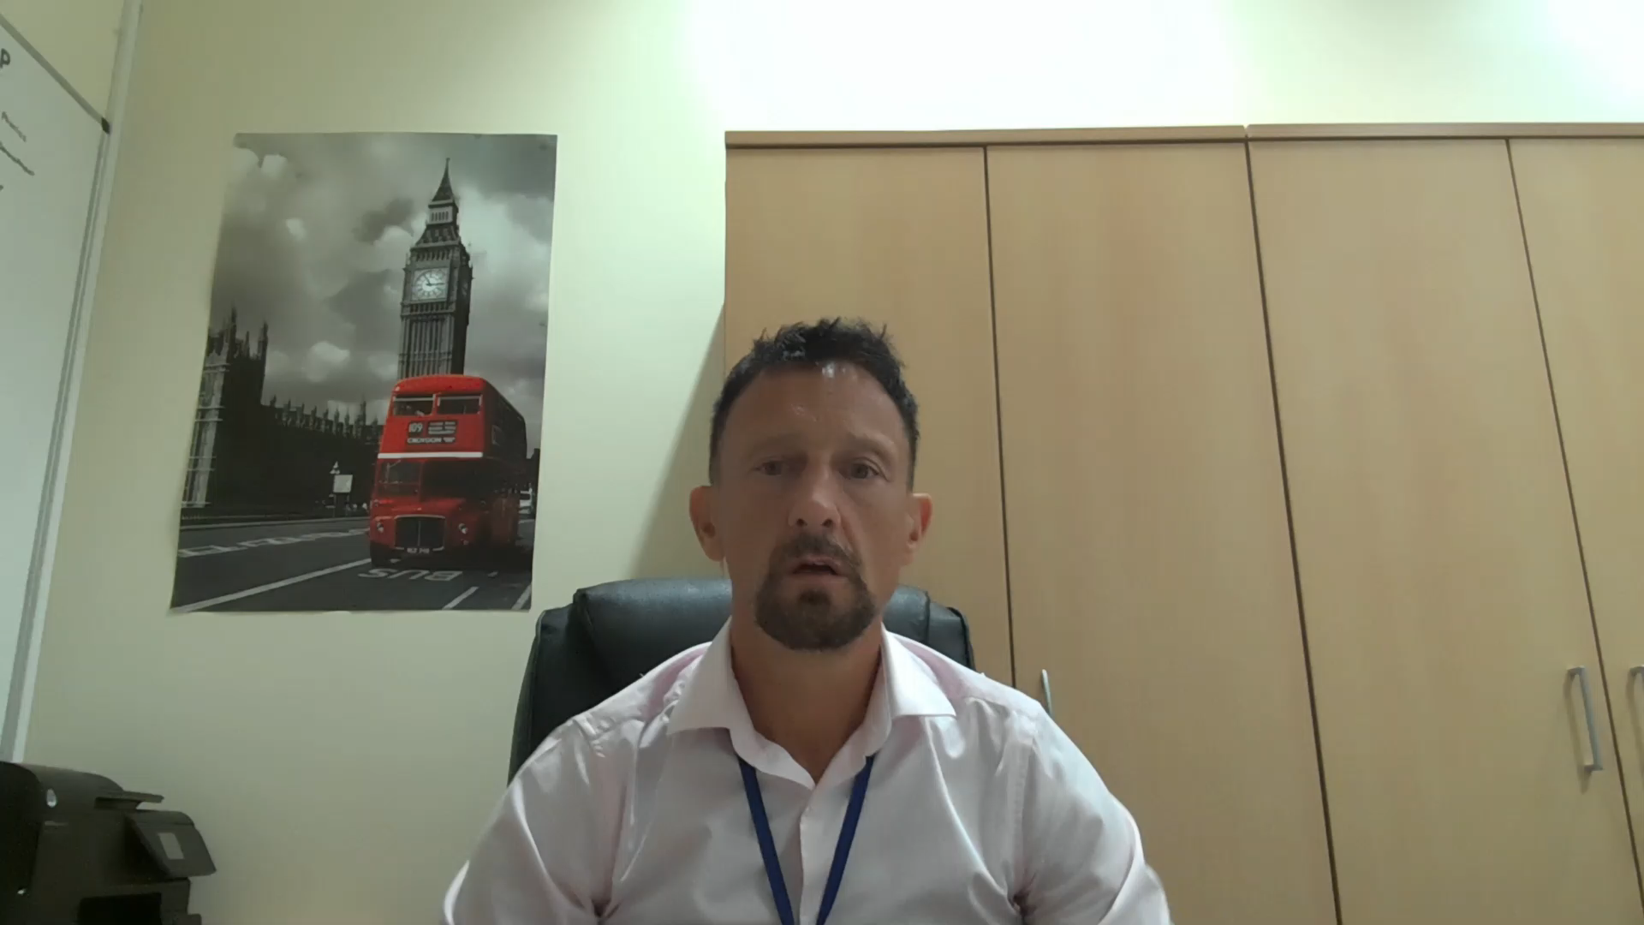


Our Vision
Click to play
 | CHILD Children at the centre Having high expectations Inclusive curriculum Love learning, Love teaching Dreaming of exciting things in school

