Slide 1
Task: Complete a Helpful hints for Resilience at school and with friendships
On the next slides are some helpful tips you could include.
Add in your own ideas too.
Add in symbols to make it attractive.
Make sure you have a good standard of writing and plenty of helpful hints!

Slide 2
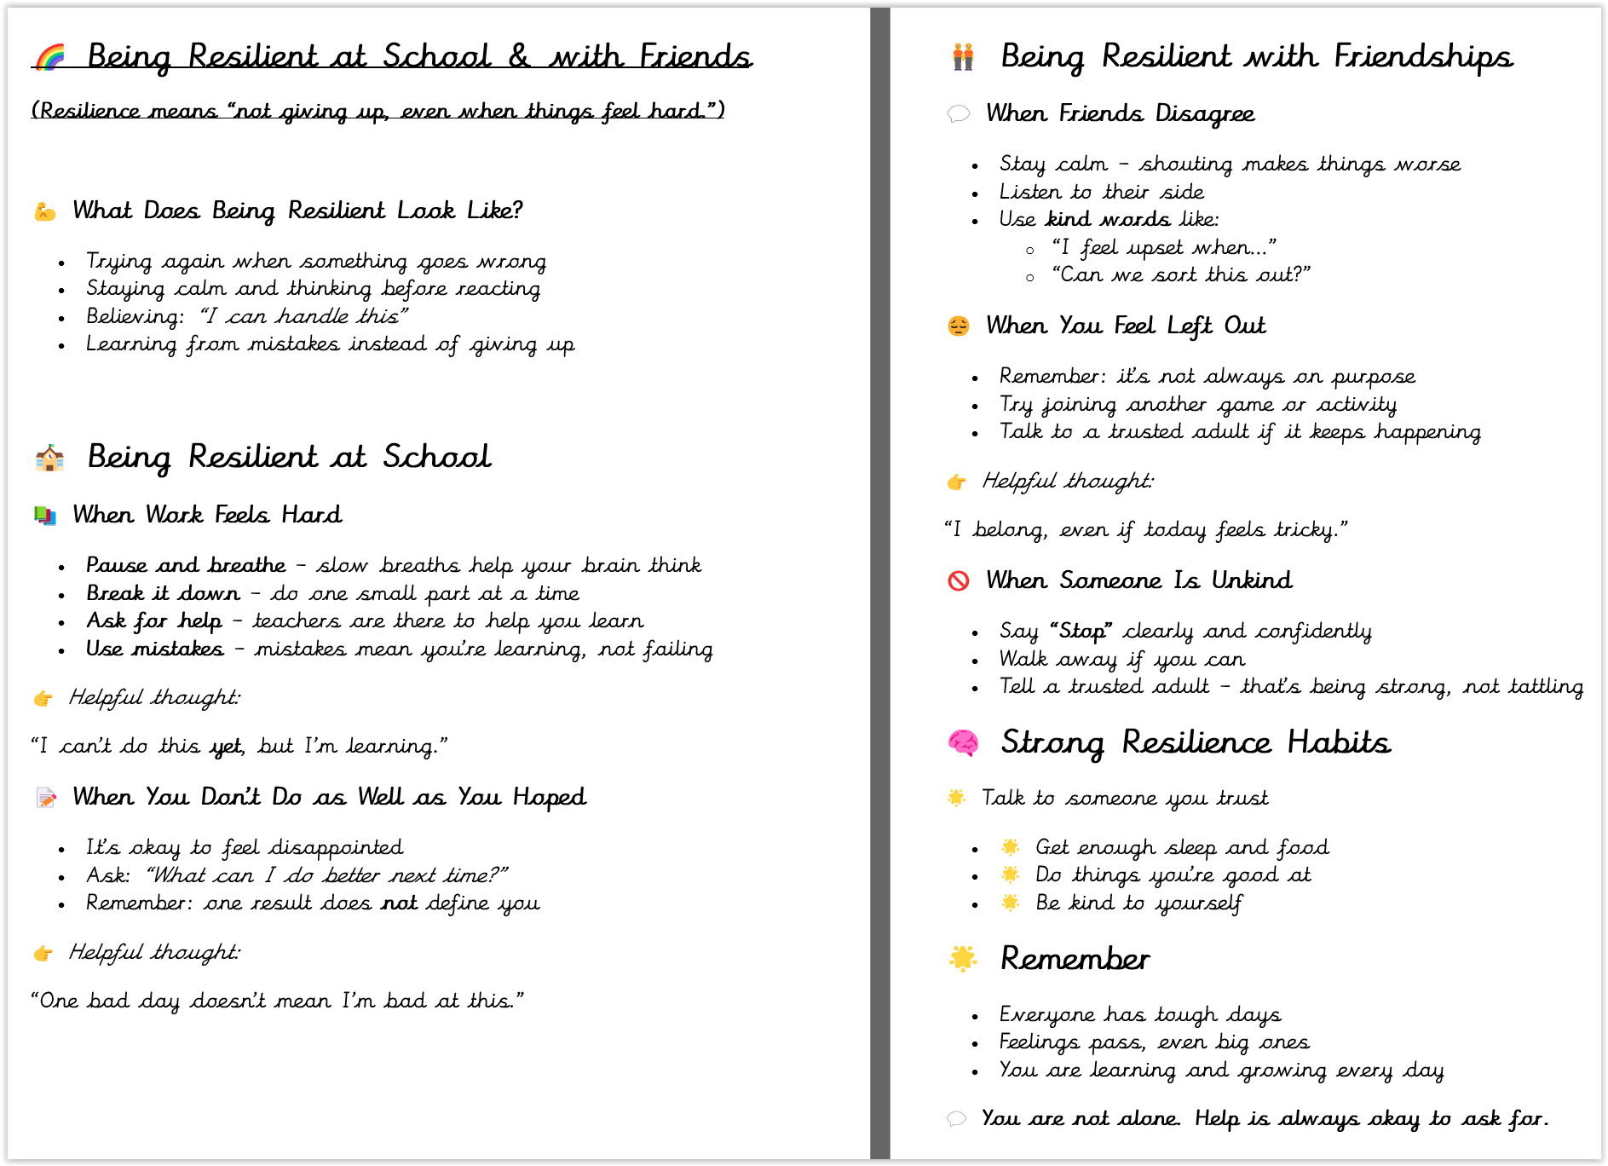

Slide 3
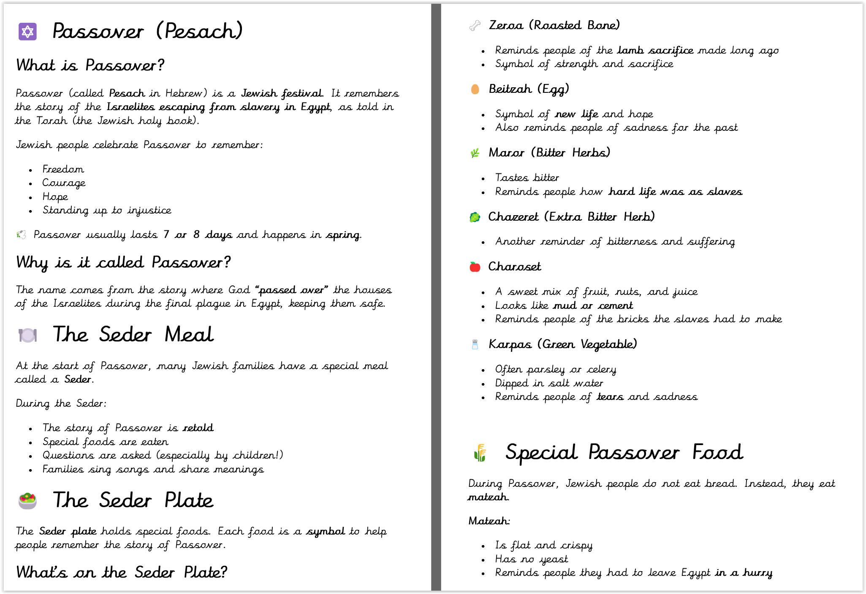

Slide 4


