Slide 1
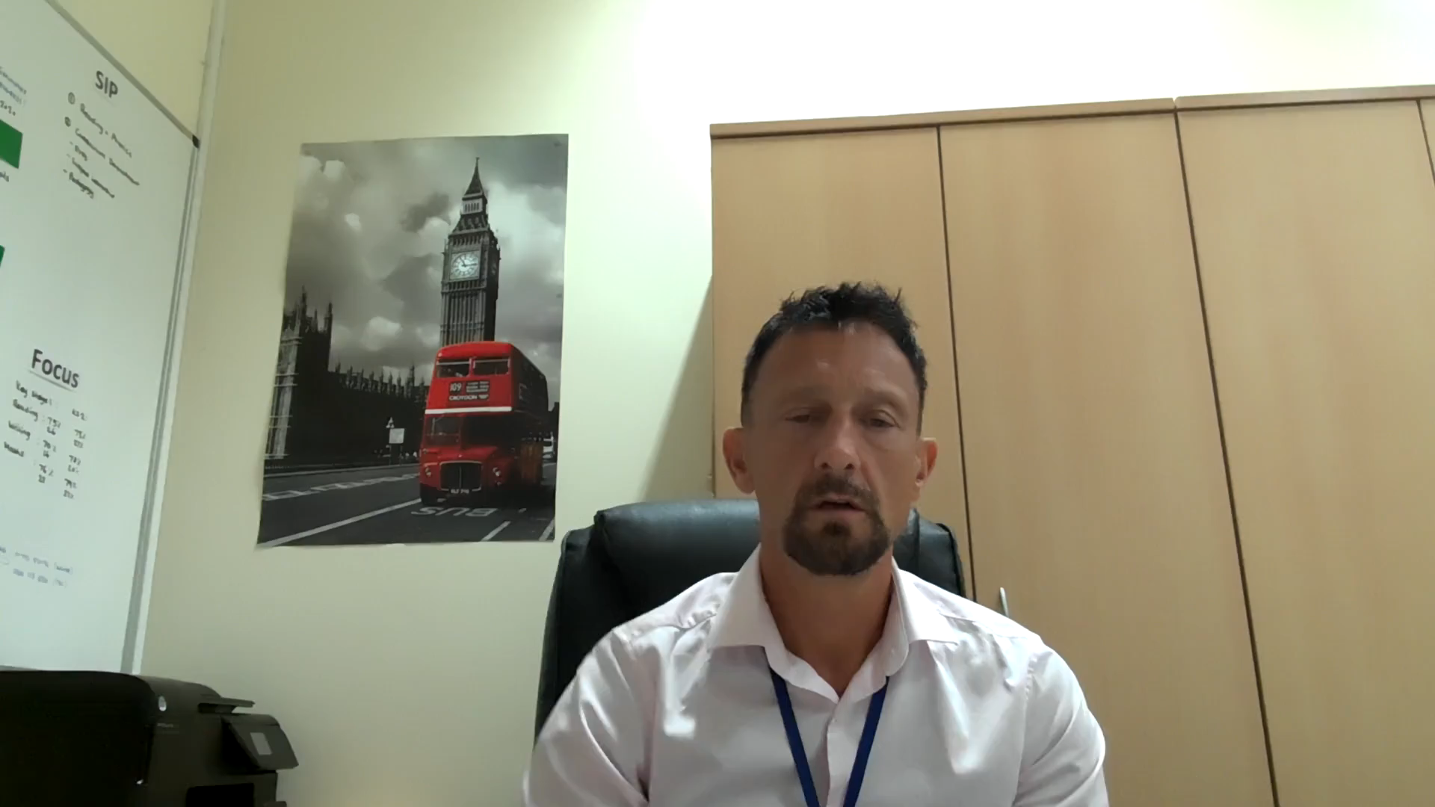
Communication
Good communication vitally important to us.
We have: an open door policy
An excellent up to date website
Letters sent home to inform parents of events
Email facility direct to parents
Texting service direct to parents
Parent Meetings
Structured conversation meetings
School reports
Weekly Newsletters
Parent Forums
Electronic communication board
A notice window
Informal meetings with teachers
A meet the teacher meeting at the beginning of the school year
Two friendly office staff
Click to play

