Slide 2
Friday 24th April
LO: To understand geographical similarities and differences of regions of the United Kingdom.
Climate
Rainfall
Human and physical geography
Population density

Slide 3
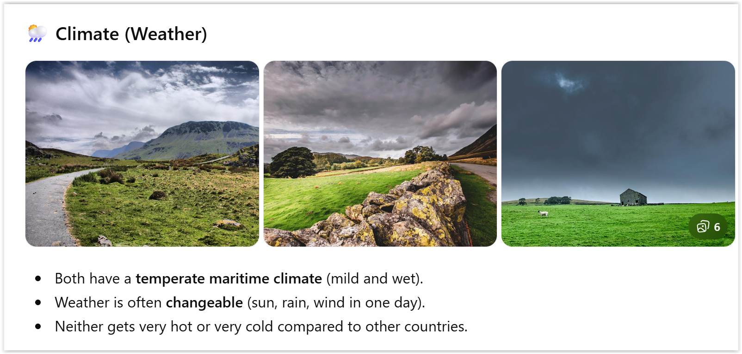

Slide 4
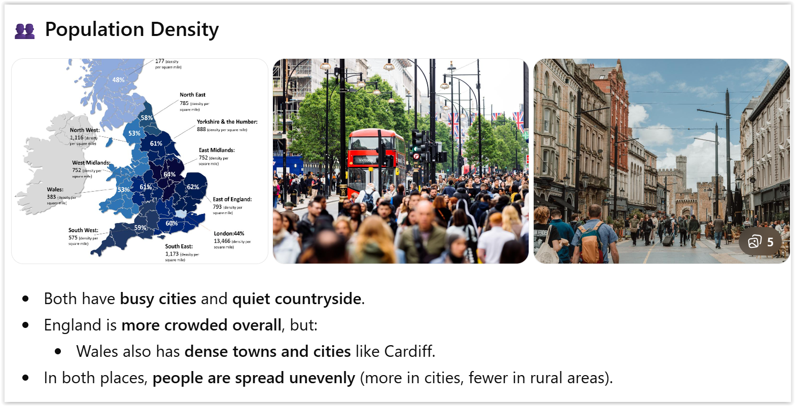

Slide 5
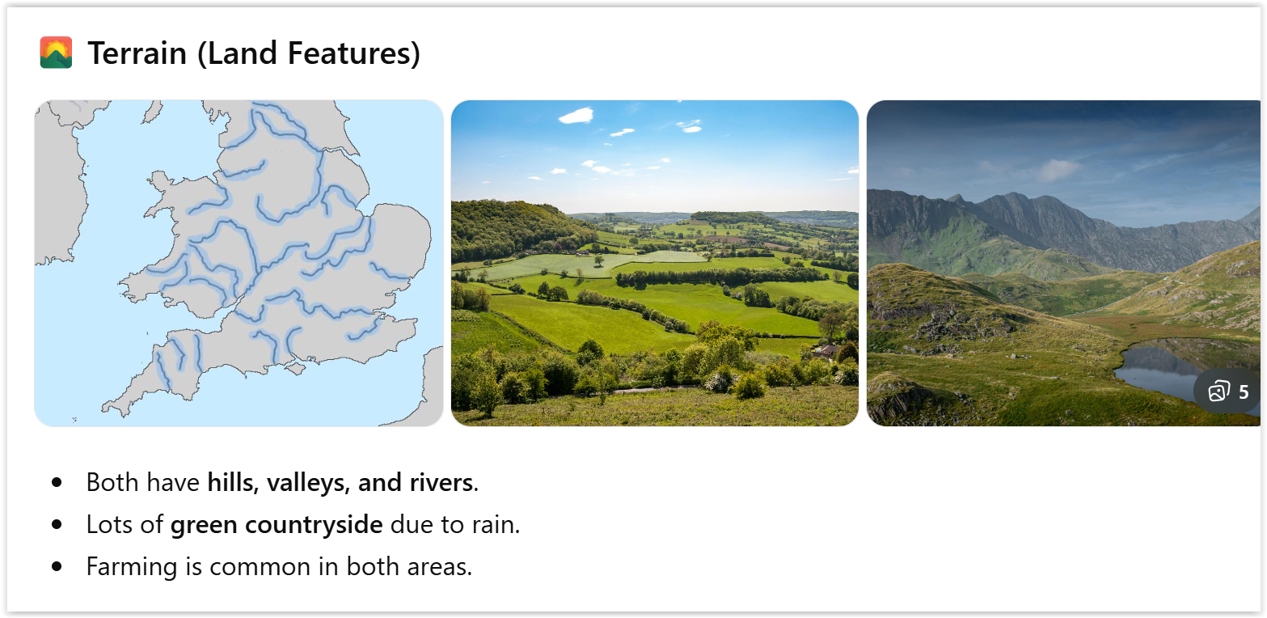

Slide 6
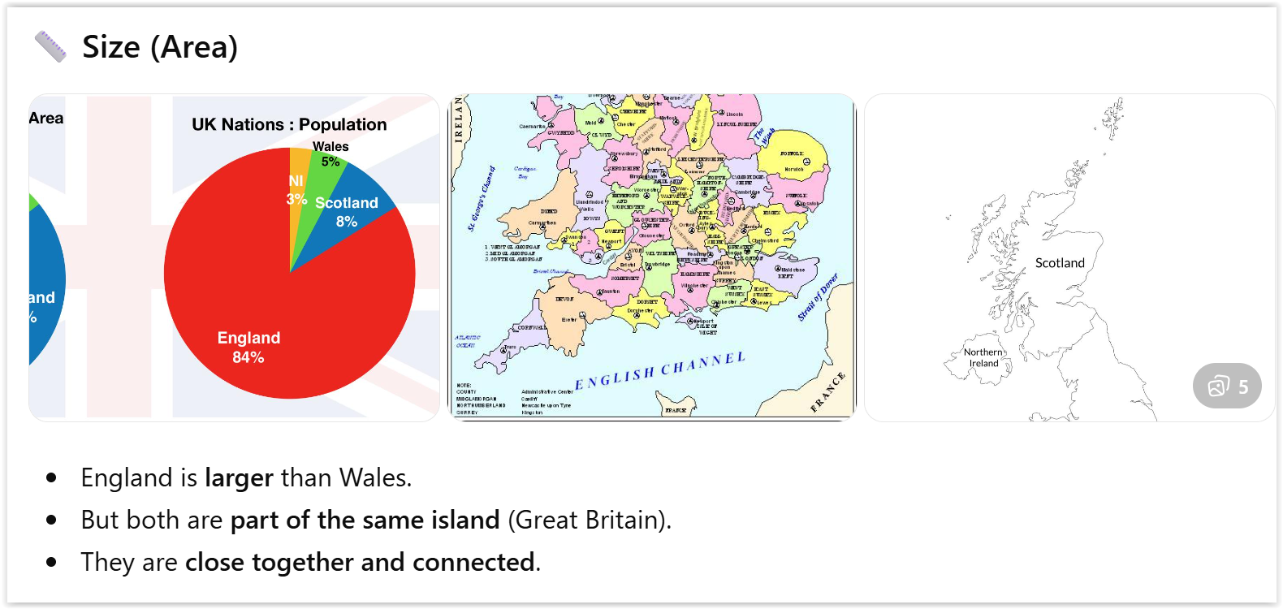

Slide 7
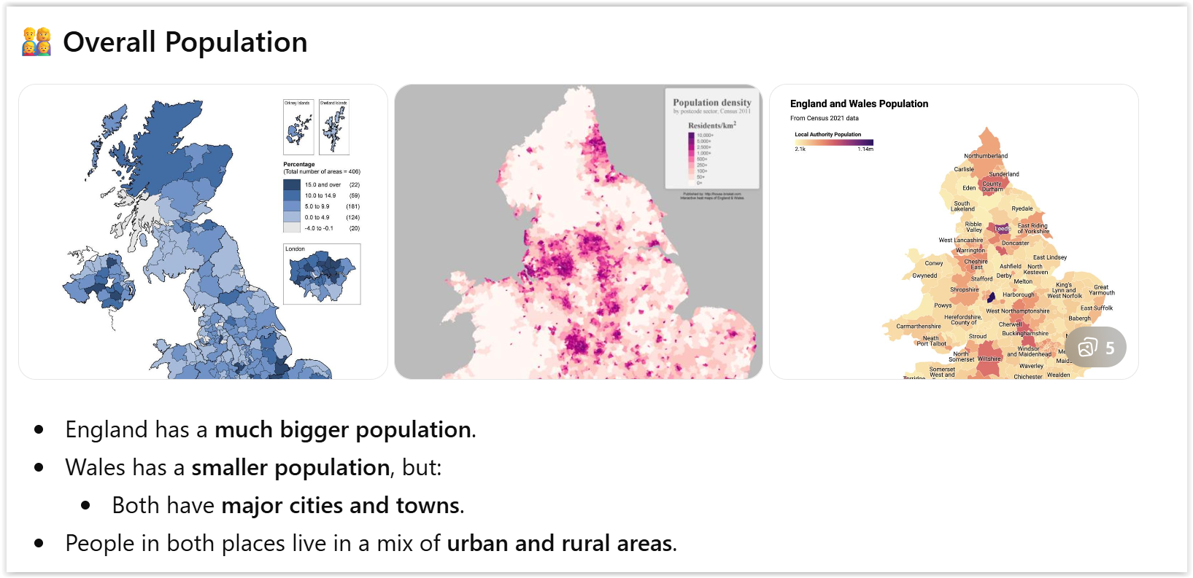

Slide 8
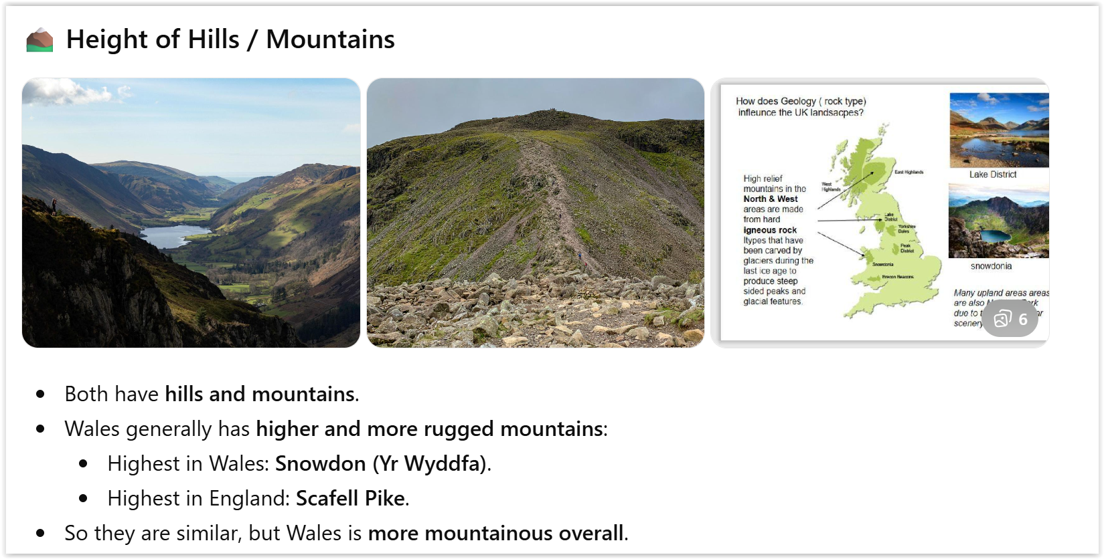

Slide 9
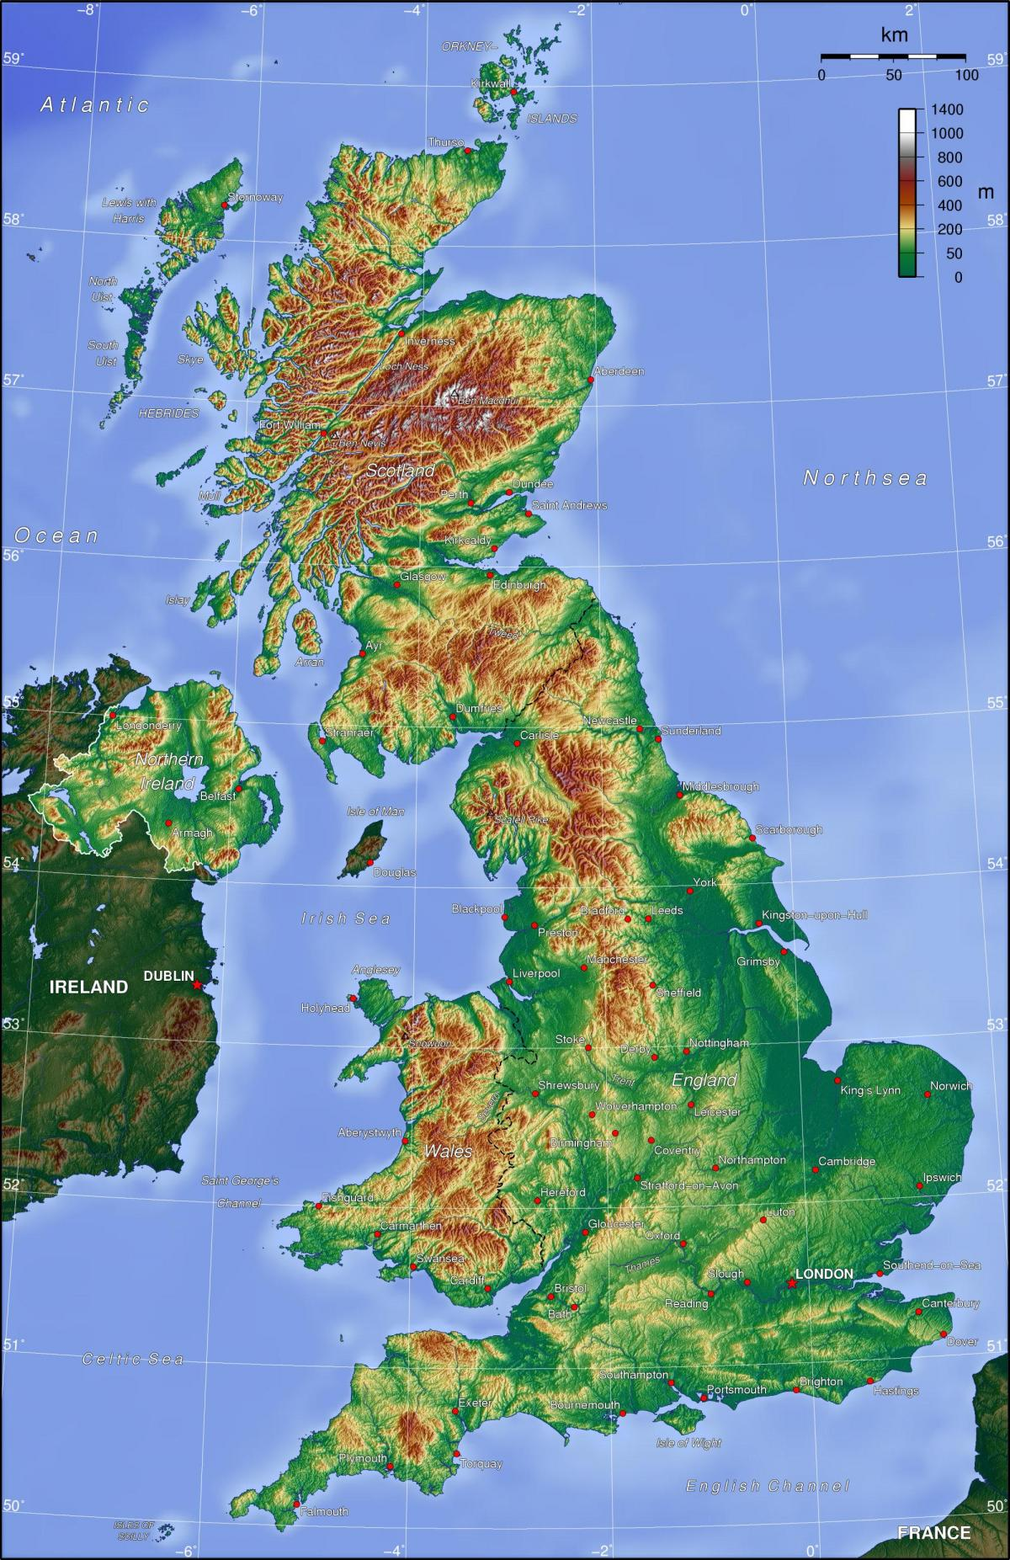
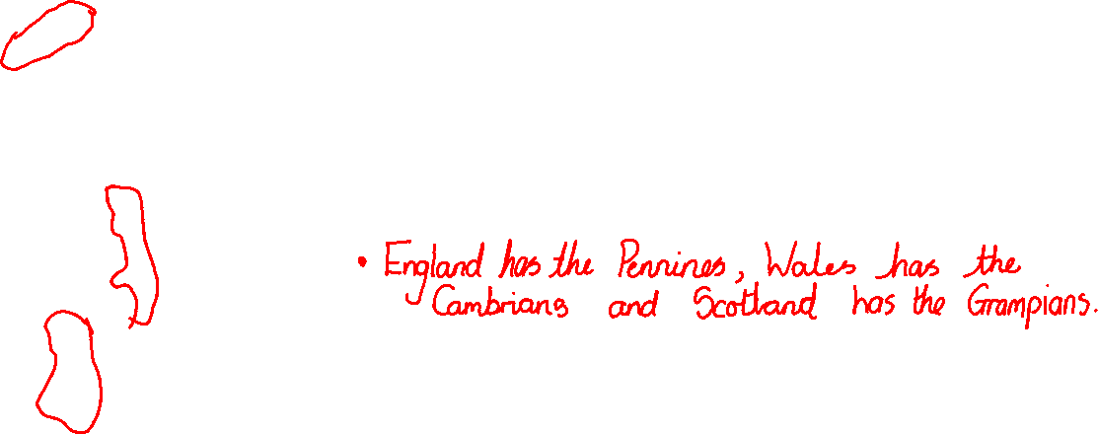
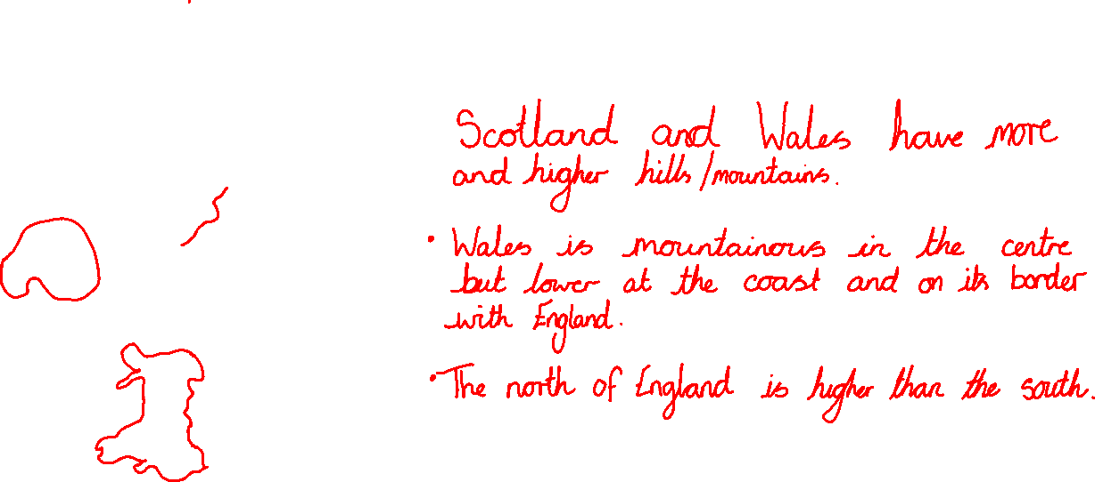
____________________________________________________________________________________________________________________________________________________________________________________________________________________________________________________________________________________________________________________________________________________________________________________________________________________________________

Slide 10
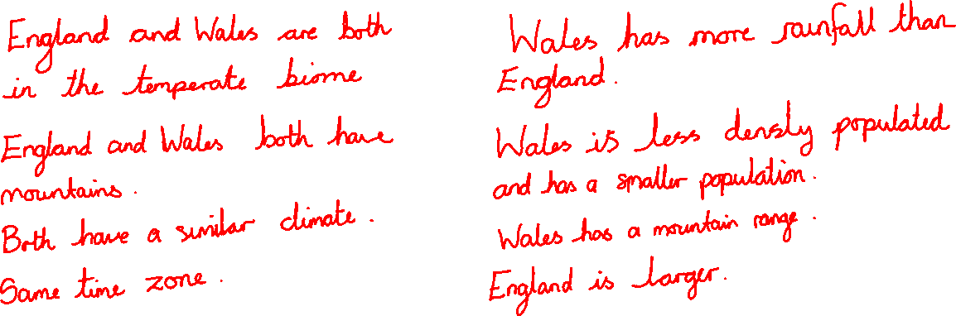
Similarities and Differences of England and Wales
Similarities
Differences

Slide 11
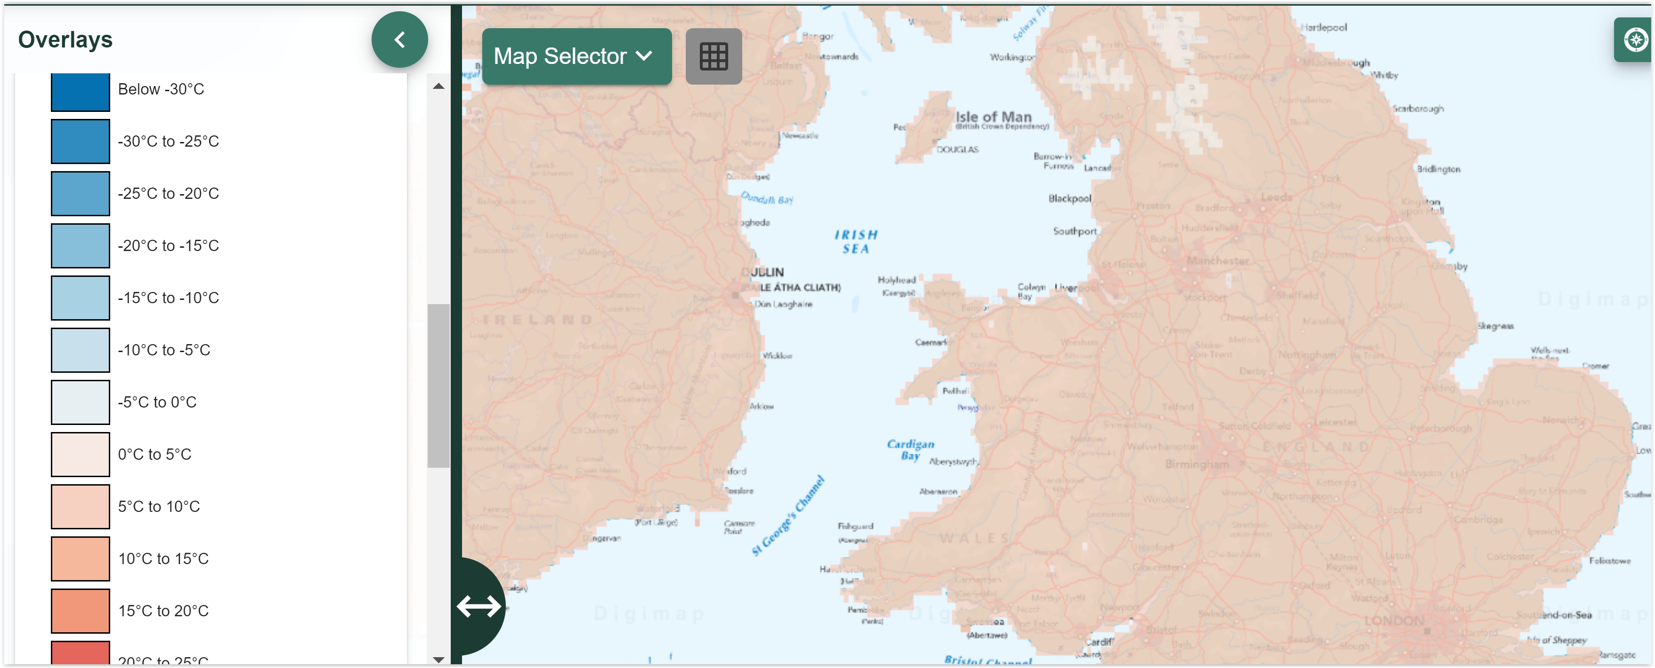
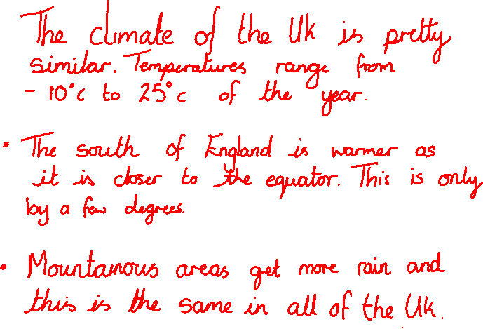
CLIMATE
________________________________________________________________________________________________________________________________________________________________________________________________________________________________________________________________________________________________

Slide 12
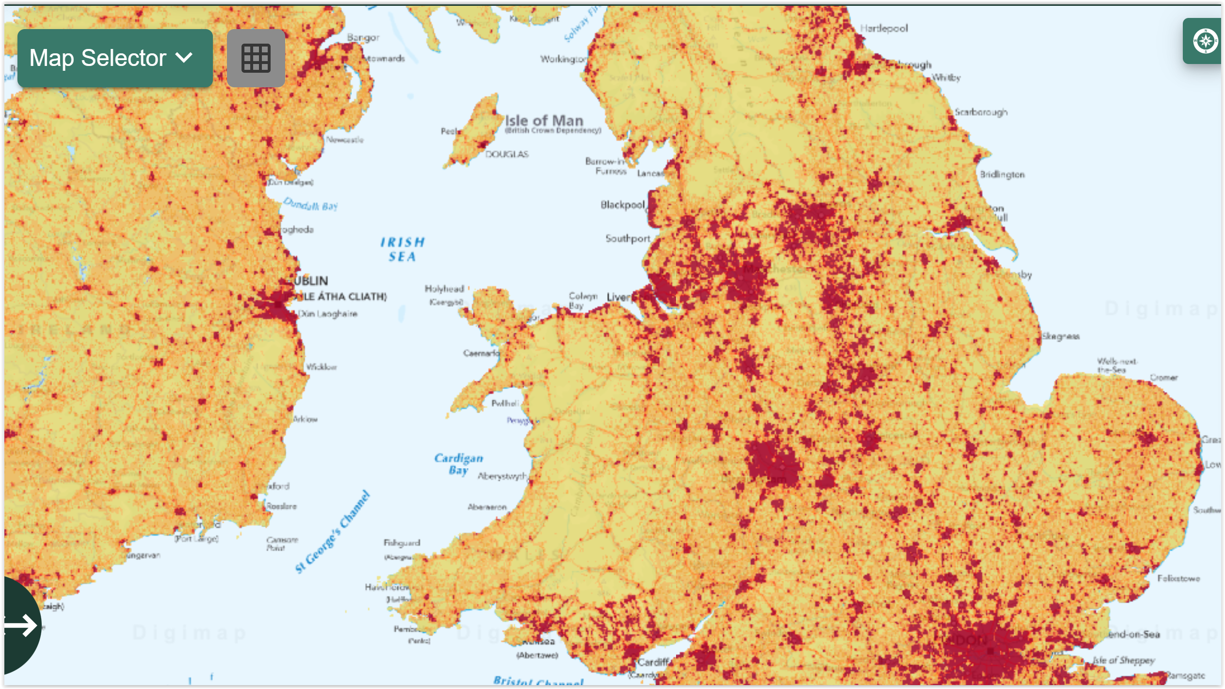
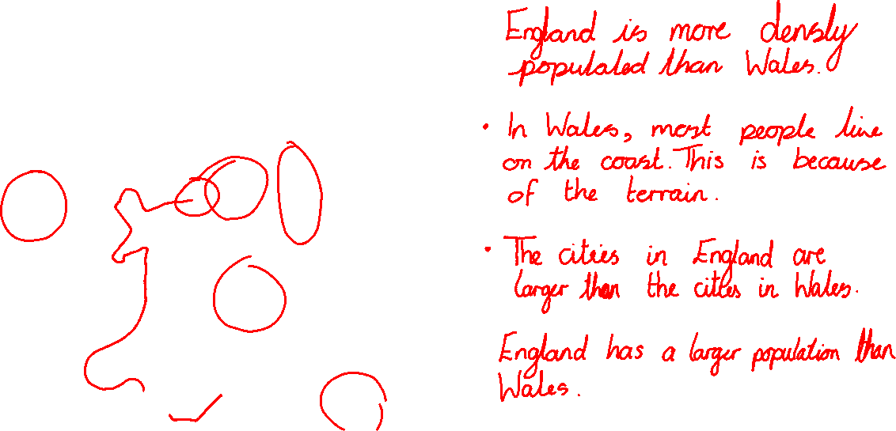
Population density
_______________________________________________________________________________________________________________________________________________________________________________________________________________________________________________________________________________________________________________________________

Slide 13
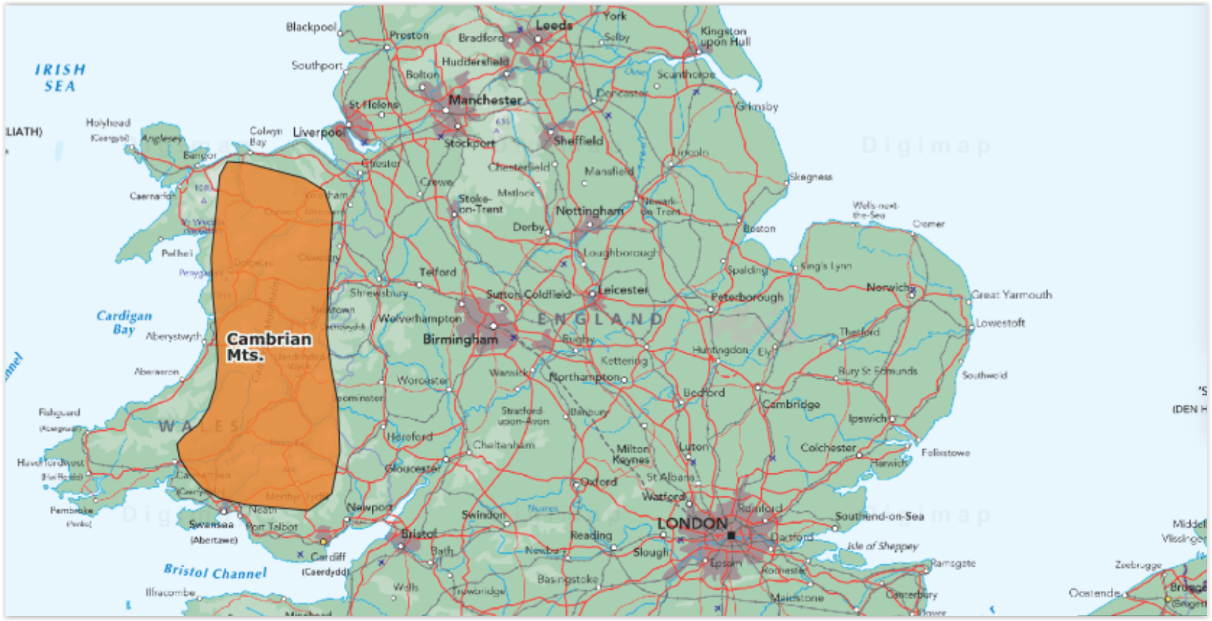
Mountain Ranges

