Slide 1
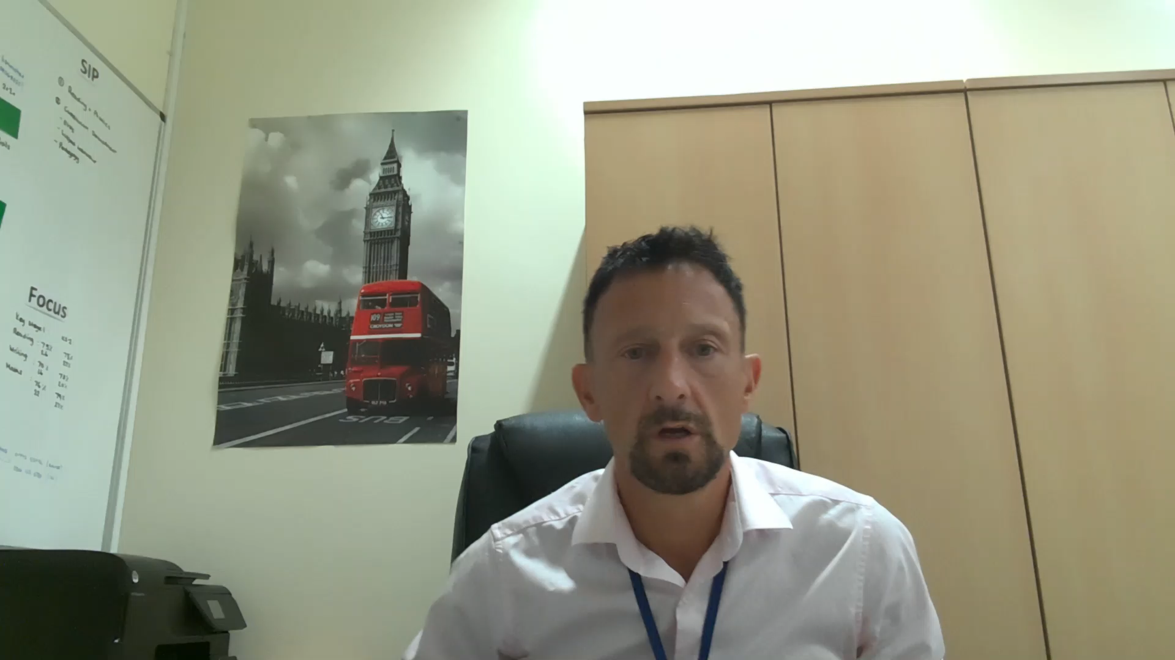
Key People for your child’s Reception Class
Miss Martin (Teaching)
Miss Ali (Teaching Assistant)
Click to play

